Slide 1
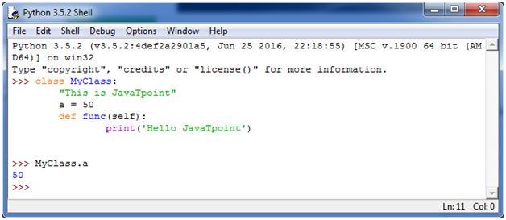
Object: Object is an entity that has state and behavior. It may be anything. It may be physical and logical. For example: mouse, keyboard, chair, table, pen etc.
Class :A class is a blueprint for the object. Let's understand it by an example:
Suppose a class is a prototype of a building. A building contains all the details about the floor, doors, windows, etc. we can make another buildings (as many as we want) based on these details. So building is a class and we can create many objects from a class.
An object is also called an instance of a class and the process of creating this object is known as instantiation.

Slide 2
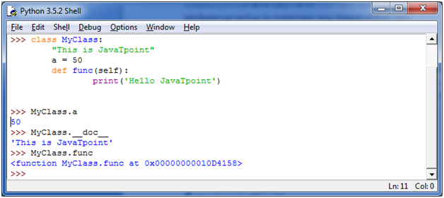
Example : __doc__ attribute. It is used to fetch the docstring of that class. When we define a class, a new class object is created with the same class name. This new class object provides a facility to access the different attributes as well as to instantiate new objects of that class

Slide 3
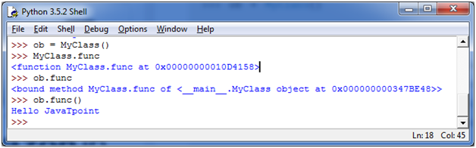
Create an Object in Python
We can create new object instances of the classes. The procedure to create an object is similar to a function call.
Let's take an example to create a new instance object ob. We can access attributes of objects by using the object name prefix.

Slide 4
Python Object Class Example
class Student:
def __init__(self, rollno, name):
self.rollno = rollno
self.name = name
def displayStudent(self):
print "rollno : ", self.rollno, ", name: ", self.name
emp1 = Student(121, "Ajeet")
emp2 = Student(122, "Sonoo")
emp1.displayStudent()
emp2.displayStudent()

Slide 5
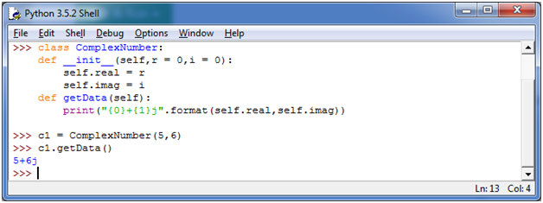
Python Constructors
A constructor is a special type of method (function) which is used to initialize the instance members of the class. Constructor can be parameterized and non-parameterized as well. Constructor definition executes when we create object of the class. Constructors also verify that there are enough resources for the object to perform any start-up task
Python Constructor Example
Let's create a class named ComplexNumber, having two functions __init__() function to initialize the variable and getData() to display the number properly.

Slide 6
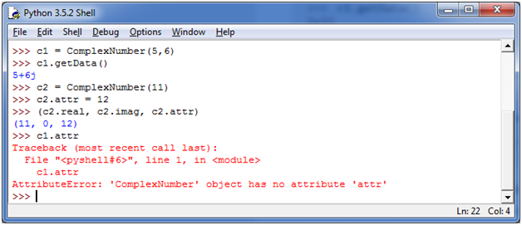

Slide 7
Python Non Parameterized Constructor Example
class Student:
# Constructor - non parameterized
def __init__(self):
print("This is non parametrized constructor")
def show(self,name):
print("Hello",name)
student = Student()
student.show("irfan")

Slide 8
Python Parameterized Constructor Example
class Student:
# Constructor - parameterized
def __init__(self, name):
print("This is parametrized constructor")
self.name = name
def show(self):
print("Hello",self.name)
student = Student("irfan")
student.show()

Slide 9
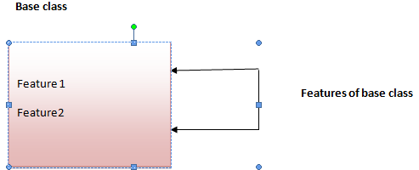
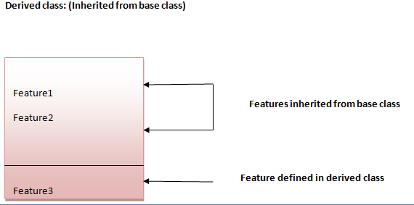
Python Inheritance
Inheritance is a feature of Object Oriented Programming. It is used to specify that one class will get most or all of its features from its parent class. It is a very powerful feature which facilitates users to create a new class with a few or more modification to an existing class. The new class is called child class or derived class and the main class from which it inherits the properties is called base class or parent class.
Image representation:

Slide 10
Python Inheritance Syntax
Syntax 1:
class DerivedClassName(BaseClassName):
<statement-1>
.
.
.
<statement-N>
Syntax 2:
class DerivedClassName(modulename.BaseClassName):
<statement-1>
.
.
.
<statement-N>

Slide 11
Python Inheritance Example
class Animal:
def eat(self):
print 'Eating...'
class Dog(Animal):
def bark(self):
print 'Barking...'
d=Dog()
d.eat()
d.bark()

Slide 12
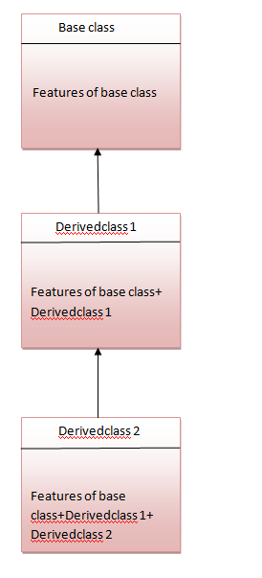
Python Multilevel Inheritance
Multilevel inheritance is also possible in Python like other Object Oriented programming languages. We can inherit a derived class from another derived class, this process is known as multilevel inheritance. In Python, multilevel inheritance can be done at any depth.

Slide 13
Python Multilevel Inheritance Example
class Animal:
def eat(self):
print 'Eating...'
class Dog(Animal):
def bark(self):
print 'Barking...'
class BabyDog(Dog):
def weep(self):
print 'Weeping...'
d=BabyDog()
d.eat()
d.bark()
d.weep()

Slide 14
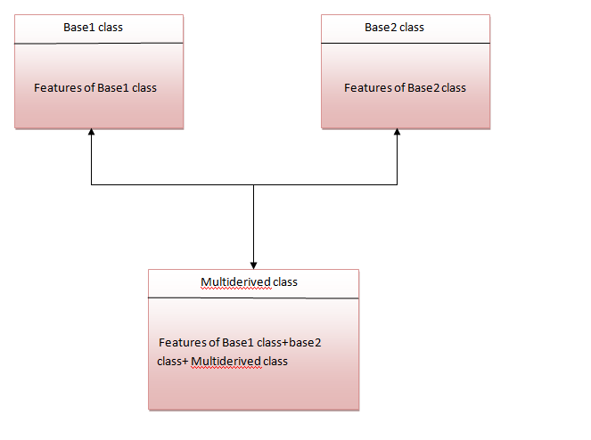
Python Multiple Inheritance
Python supports multiple inheritance too. It allows us to inherit multiple parent classes. We can derive a child class from more than one base (parent) classes.

Slide 15
class First(object):
def __init__(self):
super(First, self).__init__()
print("first")
class Second(object):
def __init__(self):
super(Second, self).__init__()
print("second")
class Third(Second, First):
def __init__(self):
super(Third, self).__init__()
print("third")
Third();

Slide 16
Method overriding in action
In Python method overriding occurs simply defining in the child class a method with the same name of a method in the parent class. When you define a method in the object you make this latter able to satisfy that method call, so the implementations of its ancestors do not come in play.
class Parent(object):
def __init__(self):
self.value = 5
def get_value(self):
return self.value
class Child(Parent):
super(Child , self).__init__()
super(Child, self).getvalue()
def get_value(self):
return self.value + 1
>>> c = Child()
>>> c.get_value()
6

Slide 17
Encapsulation :
Using OOP in Python, we can restrict access to methods and variables. This prevent data from direct modification which is called encapsulation. In Python, we denote private attribute using underscore as prefix i.e single “ _ “ or double “ __“.
class Computer:
def __init__(self):
self.__maxprice = 900
def sell(self):
print("Selling Price: {}".format(self.__maxprice))
def setMaxPrice(self, price):
self.__maxprice = price
c = Computer()
c.sell()
# change the price
c.__maxprice = 1000
c.sell()
# using setter function
c.setMaxPrice(1000)
c.sell()

Slide 18
Polymorphism: Polymorphism is an ability (in OOP) to use common interface for multiple form (data types).Suppose, we need to color a shape, there are multiple shape option (rectangle, square, circle). However we could use same method to color any shape. This concept is called Polymorphism.
class Parrot:
def fly(self):
print("Parrot can fly")
def swim(self):
print("Parrot can't swim")
class Penguin:
def fly(self):
print("Penguin can't fly")
def swim(self):
print("Penguin can swim")

Slide 19
# common interface
def flying_test(bird):
bird.fly()
#instantiate objects
blu = Parrot()
peggy = Penguin()
# passing the object
flying_test(blu)
flying_test(peggy)

